Slide 1

elixir and OTP apps
introduction

Slide 2
content
Elixir
  history
  iex
  types
  operators
  patter matching
  control flow structures
  functions
  modules
  recursion
  pipe operator
  comprehensions
  processeses
OTP
  scalability
  fault tolerance
  concurrency
  history
  behaviours
  ets
  mix
Workshop
  observer
Resources
Q&A

Slide 3


Slide 4
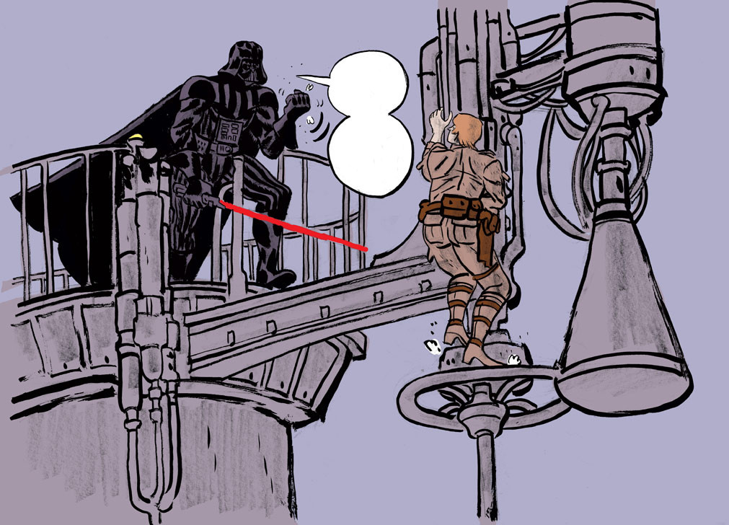


history
Elixir !!
I am your
Father !!

Slide 5
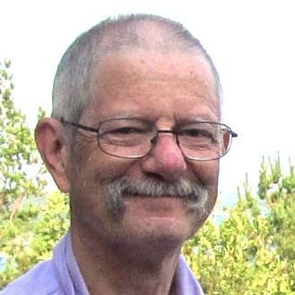
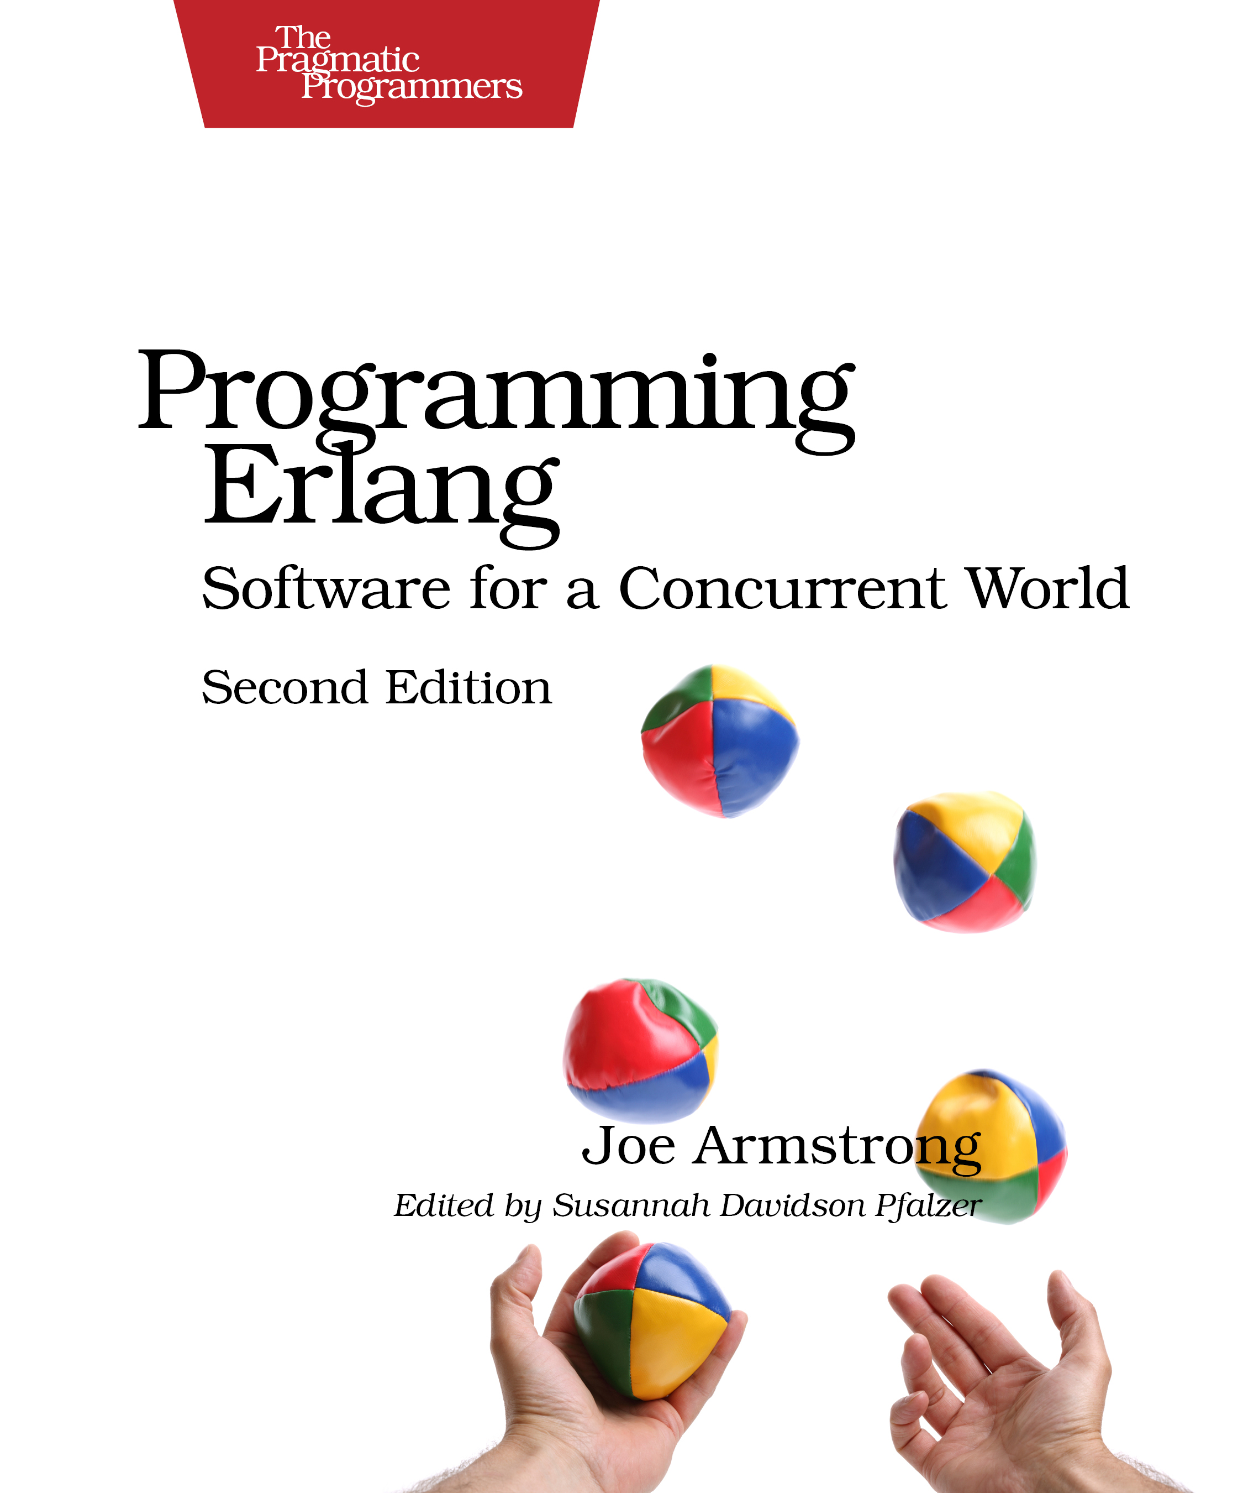
history
Joe designed erlang in the 80s, when he was an Ericsson engineer, focusing on:
Scalability
Fault Tolerance
Concurrency

Slide 6


history
Moore’s law is almost over, but it is too easy to have multicore pc.
Languages like Python, Javascript or Ruby can’t take advantage of several CPUs

Slide 7

history
Jose Valim tried to improve Ruby on Rails framework, but he could not. Then, he discovered how Erlang worked, but he did not like the syntax, therefore he decided to create a new language which will run in the BEAM (Erlang Virtual Machine).

Slide 8
history
Elixir is a functional, concurrent, general-purpose programming language that runs on the Erlang virtual machine (BEAM). Elixir builds on top of Erlang and shares the same abstractions for building distributed, fault-tolerant applications. Elixir also provides a productive tooling and an extensible design. The latter is supported by compile-time metaprogramming with macros and polymorphism via protocols.

Slide 9
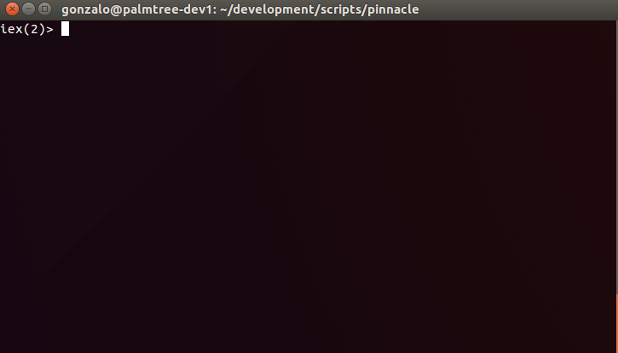
iex

Slide 10
types
Elixir is a dynamic language, but of course it has types:
1 | INTEGER
0X1F | INTEGER
1.0 | FLOAT
true | BOOLEAN*
:atom | ATOM
“string” | STRING
[1, 2, 3] | LIST
{1, 2, 3} | TUPLE
%{id: 1, text: “example”} | MAP
%{“id” => 1, “text”: “example”} | MAP
%Person{id: 1, name: “Antonio”} | STRUCT
pid(23, 32, 45) | PID
nil | *

Slide 11
operators
+ | 2 + 2 = 4
- | 3 – 2 = 1
* | 2 * 2 = 4
/ | 10 / 2 = 5
++ | [1, 2, 3] ++ [4, 5, 6] = [1, 2, 3, 4, 5, 6]
<> | "foo" <> "bar" = “foobar”
and | true and false = false
or | true or false = true
! | !true = false
|| | 1 || false = 1
&& | nil && 13
== | 1 == 1 = true
!= | 1 != 1 = false
=== | 1 === 1.0 = false
< | 1 > 1 = false
> | 1 < 1 = false

Slide 12
pattern matching
The pattern match operator is “=”
iex()> x = 1
1
iex()> {a, b, _} = {:ok, 2, 3}
{:ok, 2, 3}
iex()> [head | tail] = [1, 2, 3]
[1, 2, 3]
iex()> head
1
iex()> tail
[2, 3]
iex()> %{id: id} = %{id: 1, text: “example”}
%{id: 1, text: “example”}
iex()> id
1

Slide 13
control flow structures
Case compares a value against many patterns until we find a matching one:
iex> x = {1, 2, 3}
{1, 2, 3}
iex> case x do
...> {2, 3, 4} → “First option”
...> {1, _, 3} → “Second Option”
...> _ → “It always matches”
...> end
“Second Option”
iex> x = {1, 7, 3}
{1, 2, 3}
iex()> case x do
...> {2, 3, 4} → “First option”
...> {1, _, 3} → “Second Option”
...> _ → “It always matches”
...> end
“Second Option”
You can also use guards in your pattern matching: {1, z, 3} when z > 0 → “guards !!!”

Slide 14
control flow structures
Cond allows us to check different conditions until we find the first true.
iex> x = {1, 2, 3}
{1, 2, 3}
iex> cond do
...> x == {2, 3, 4} → “First option”
...> is_list(x) → “It is a list !!”
...> 2 + 5 == x → “ it is 7 !!”
...> true → “It always matches”
...> end
“It always matches”

Slide 15
control flow structures
If and unless are macros, but you can normally use them ;).
iex> x = {1, 2, 3}
{1, 2, 3}
iex> if {1, 2, 3} == x do
...> “Yes, it is”
...> else
...> “No, it is not”
...> end
“Yes, it is”
iex> unless {1, 2, 3} == x do
...> “No, it is not”
...> else
...> “Yes, it is”
...> end
“Yes, it is”

Slide 16
functions
Functions are first citizens in elixir. Don’t forget the “.” if it is an anonymous one.
iex> square = fn x → x*x end
Function<6.52032458/1 in :erl_eval.expr/5>
iex> square.(2)
4
iex>my_very_difficult_algo = fn x -> square.(x) end
#Function<6.52032458/1 in :erl_eval.expr/5>
iex> my_very_difficult_algo.(2)
4

Slide 17
modules
The functions are grouped in Modules.
iex> defmodule MyCalculator do
...> def square(x) do
...> x * x
...> end
...> end
{:module, MyCalculator,
<<70, 79, 82, 49, 0, 0, 4, 212, 66, 69, 65, 77, 69, 120, 68, 99, 0, 0, 0, 147,
131, 104, 2, 100, 0, 14, 101, 108, 105, 120, 105, 114, 95, 100, 111, 99, 115,
95, 118, 49, 108, 0, 0, 0, 4, 104, 2, ...>>, {:square, 1}}
iex> MyCalculator.square(2)
4

Slide 18
modules
Elixir has a lot of standard modules that you will take advantage of them.
Enum
List
Map
Stream
String
Integer
Process
...

Slide 19
modules
But Elixir works in the BEAM, so we can also use all the standard modules of Erlang.
:os
:calendar
:rand
:ets
:crypto
:global
...

Slide 20
recursion
How are we going to code my things if I don’t have loops?
iex> defmodule Fib do
...> def calculate(x), do: fib(x)
...> defp fib(1), do: 1
...> defp fib(2), do: 1
...> defp fib(x), do: fib(x - 1) + fib(x - 2)
...> end
{:module, Fib,
<<70, 79, 82, 49, 0, 0, 6, 20, 66, 69, 65, 77, 69, 120, 68, 99, 0, 0, 0, 163,
131, 104, 2, 100, 0, 14, 101, 108, 105, 120, 105, 114, 95, 100, 111, 99, 115,
95, 118, 49, 108, 0, 0, 0, 4, 104, 2, ...>>, {:fib, 4}}
iex> Fib.calculate(7)
13

Slide 21
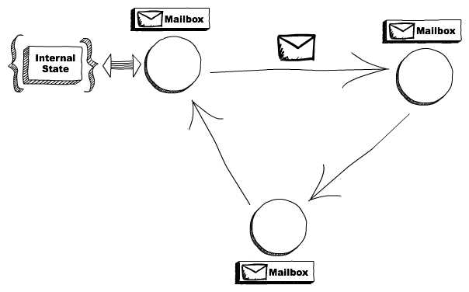
Processes
Elixir (and Erlang) follows the actor model paradigm.
Every process (Erlang process) has his own mailbox and it communicates using messages

Slide 22
Processes
Self communication !!
iex> Process.send(self(), “Hello from Process.send()”, [])
iex> send(self(), “Hello send()”)
iex> receive do
...> msg → msg
...> end
"Hello from Process.send()"
iex> receive do
...> msg → msg
...> end
"Hello from send()"

Slide 23
Processes
Communication from outside !!
iex> spawn(fn -> send(parent, {:hello, self()}) end)
#PID<0.48.0>
iex> receive do
...> {:hello, pid} -> "Got hello from #{inspect pid}"
...> end
Got hello from #PID<0.48.0>

Slide 24
Processes
I highly recommend to use Task !!
iex> Task.start(fn -> send(parent, {:hello, self()}) end)
{:ok, #PID<0.48.0>}
iex> receive do
...> {:hello, pid} -> "Got hello from #{inspect pid}"
...> end
Got hello from #PID<0.48.0>
iex> task = Task.async(fn -> 2 + 2 end)
%Task{owner: #PID<0.80.0>, pid: #PID<0.82.0>, ref: #Reference<0.0.1.211>}
iex> middle_sum = 3 + 5
8
iex> result = middle_sum + Task.await(task)
12

Slide 25
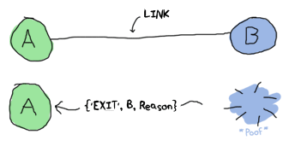
processes
Linked Processes: If one process dies, the other dies as well
Monitored Process: If a monitored process dies, the monitor process will receive a notification.
Linking: You can start a process with the function start_link() instead of start or just use Process.link(pid) from one process indicating the pid of the other process.
Monitoring: Execute Process.monitor(pid) from one process indicating the pid of the other process.

Slide 27
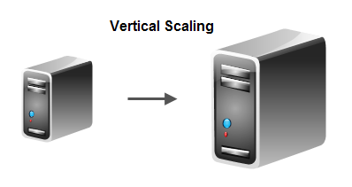
scalability
Vertical scalability means: “If you have a ‘bigger’ server, your SW will take advantage of it.”
We have already talk about vertical scalability, but I love this gift

Slide 28
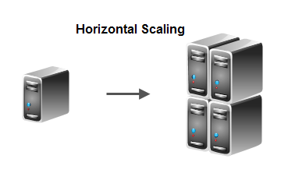
scalability
Vertical scalability can reach some limitations, but we need to scale, the solution can be horizontal scalability, or adding more servers. It also implies distribution.

Slide 29

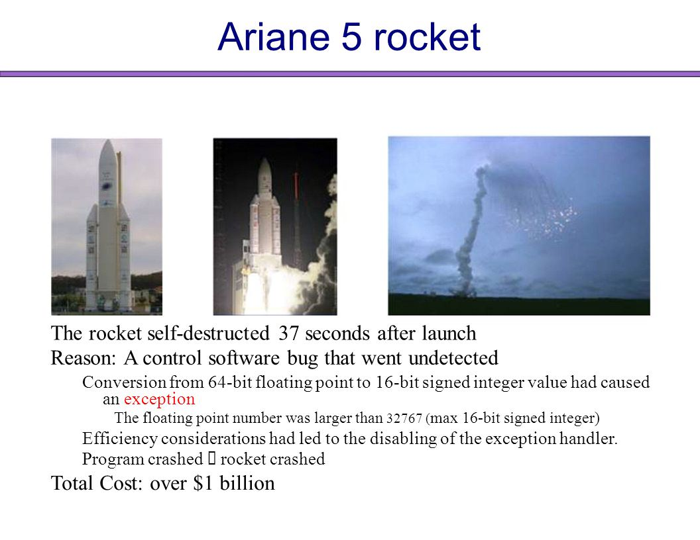
fault tolerance
The only SW that has not bug is the SW that has never been executed.
SWs which run indefinitely have to be fault tolerance.
The only SW that has no bug is the SW that has never been executed.
SWs which run indefinitely have to be fault tolerance.
Really good
Exampe !!

Slide 30
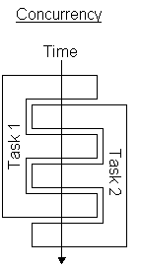
concurrency
Although we are able to scale in order to use more CPU cores, sure that you will have more tasks than cores, so you need concurrency.

Slide 31

history
Having all this things in mind, the Ericsson guys developed OTP which is a collection of useful middle-ware, libraries, and tools written in Erlang programming language.
Ericsson OTP Team
Twitter: @erlang_org

Slide 32
behaviours
Behaviours in Elixir (and Erlang) are a way to separate and abstract the generic part of a component (which becomes the behaviour module) from the specific part (which becomes the callback module).
The following are provided by OTP (and some new ones from Elixir):
Supervisor
GenServer
GenStage
Agent
GenEvent

Slide 33
behaviours
A Supervisor is a process which supervises other processes, which are referred to as child processes. (Do you remember the linking/monitoring actions?)
# Import helpers for defining supervisors
import Supervisor.Spec
# Supervise the Stack server which will be started with
# a single argument [:hello] and the default registered
# name of MyStack.
children = [
worker(MyProcess, [[:hello], [name: :my_process]])
]
# Start the supervisor with our child
{:ok, pid} = Supervisor.start_link(children, strategy: :one_for_one)

Slide 34
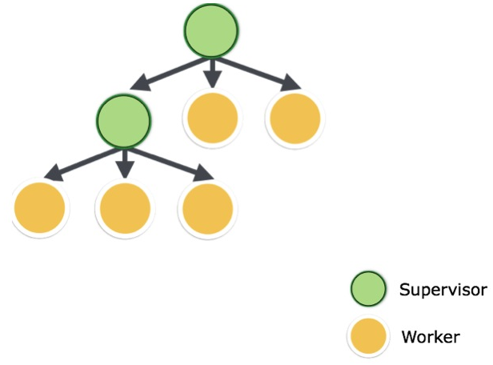
behaviours
A Supervisor can supervises a worker (Elixir Process) or other supervisors.

Slide 35
behaviours
A GenServer is a process like any other Elixir process and it can be used to keep state, execute code asynchronously and other interesting stuffs providing a standard set of interface functions and include functionality for tracing and error reporting. It will also fit into a supervision tree.
defmodule Stack do
use GenServer
# Callbacks
def handle_call(:pop, _from, [h | t]) do
{:reply, h, t}
end
def handle_cast({:push, item}, state) do
{:noreply, [item | state]}
end
end
# Start the server
{:ok, pid} = GenServer.start_link(Stack, [:hello])
# This is the client
GenServer.call(pid, :pop)
#=> :hello
GenServer.cast(pid, {:push, :world})
#=> :ok
GenServer.call(pid, :pop)
#=> :world

Slide 36
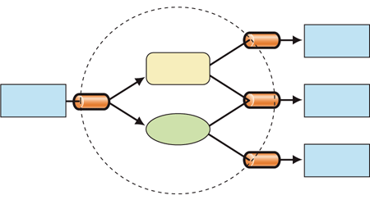
behaviours
GenStage provides the interface to create a distributed set of producer, producer-consumer and consumer processes with back-pressure mechanism. It is based on GenServer.
Consumer
Consumer
Prod-Cons
Prod-Cons
Producer
Consumer
Prod-Cons
Consumer

Slide 37
ets
ETS is a cache system which allows us to store any Elixir term in an in-memory table.
iex> table = :ets.new(:my_table, [:named_table])
:my_table
iex> :ets.insert(table, {"foo", self})
true
iex> :ets.lookup(table, "foo")
[{"foo", #PID<0.80.0>}]
iex> :ets.delete(table, "foo")
true

Slide 38
mix
Mix is a build tool that ships with Elixir that provides tasks for creating, compiling, testing your application, managing its dependencies and much more
$> mix new my_project --sup
* creating README.md
* creating .gitignore
* creating mix.exs
* creating config
* creating config/config.exs
* creating lib
* creating lib/my_project.ex
* creating test
* creating test/test_helper.exs
* creating test/my_project_test.exs
Your Mix project was created successfully.
You can use "mix" to compile it, test it, and more:
cd my_project
mix test
Run "mix help" for more commands.
$> cat my_project/mix.exs
defmodule MyProject.Mixfile do
use Mix.Project
def project do
[app: :my_project,
version: "0.1.0",
elixir: "~> 1.3",
build_embedded: Mix.env == :prod,
start_permanent: Mix.env == :prod,
deps: deps()]
end
# Configuration for the OTP application
#
# Type "mix help compile.app" for more information
def application do
[applications: [:logger],
mod: {MyProject, []}]
end
# Dependencies can be Hex packages:
#
# {:mydep, "~> 0.3.0"}
#
# Or git/path repositories:
#
# {:mydep, git: "https://github.com/elixir-lang/mydep.git", tag: "0.1.0"}
#
# Type "mix help deps" for more examples and options
defp deps do
[]
end
end

Slide 39
Workshop

Slide 40
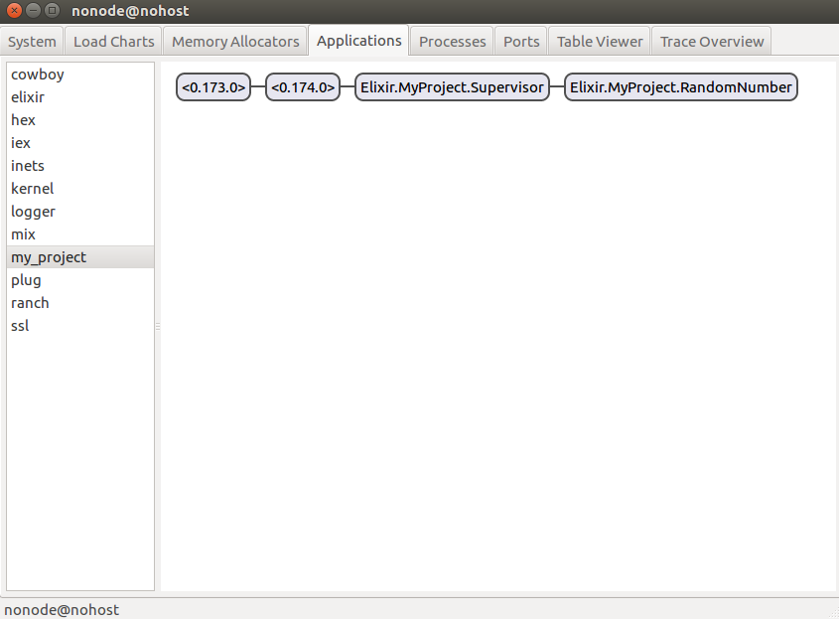
observer

Slide 41
Resources

Slide 42
resources
http://elixir-lang.org/
http://elixir-lang.org/docs/stable/elixir/
http://erlang.org/doc/reference_manual/
https://github.com/elixir-lang/elixir
https://elixir-slackin.herokuapp.com/
https://www.elixirforum.com/

Slide 43
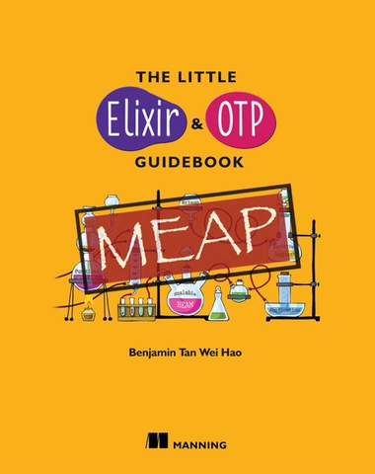
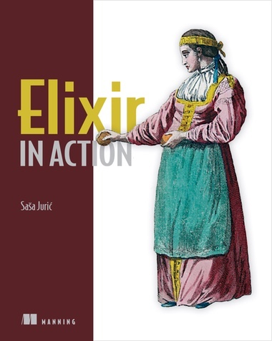
resources

Slide 44
Q&A

